Slide 1
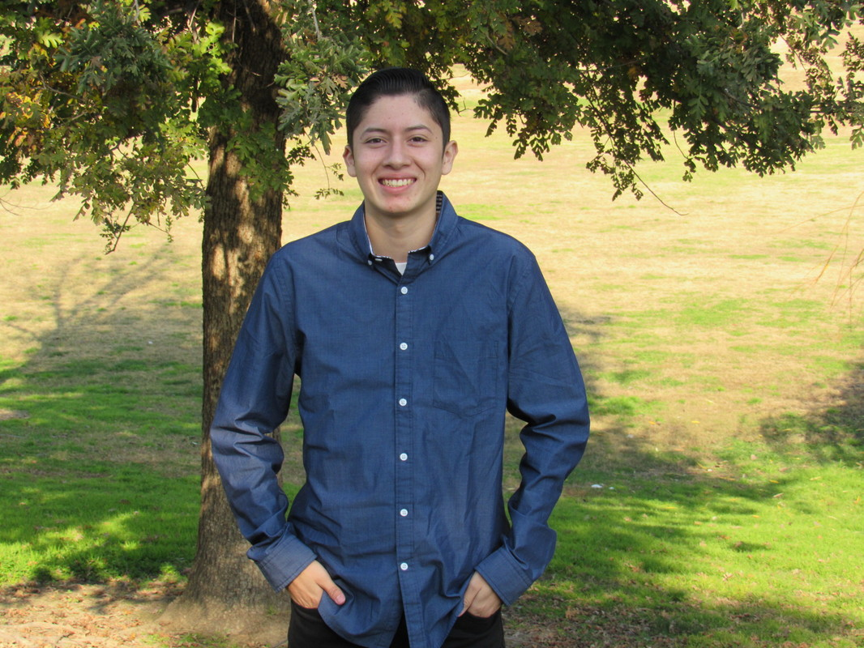
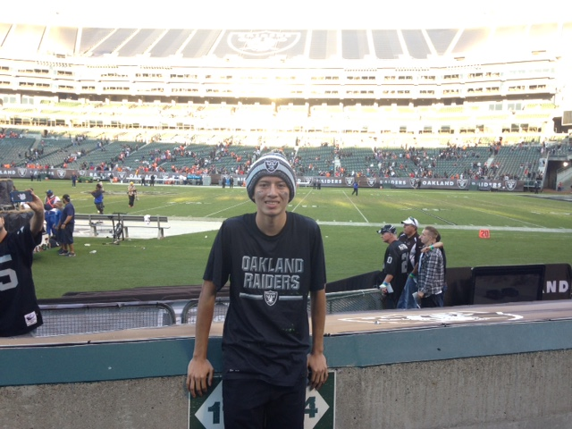
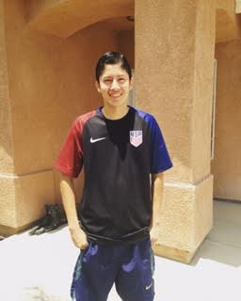
Jesus Hernandez-Espinoza
C/O 2017

Slide 2
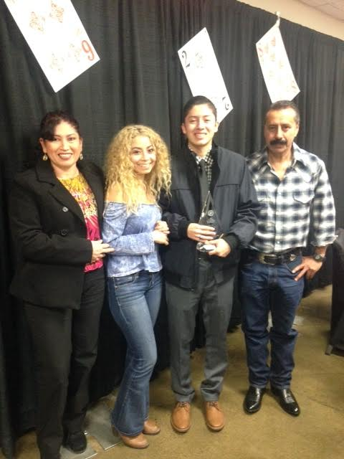
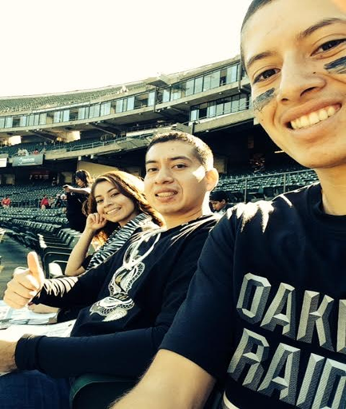
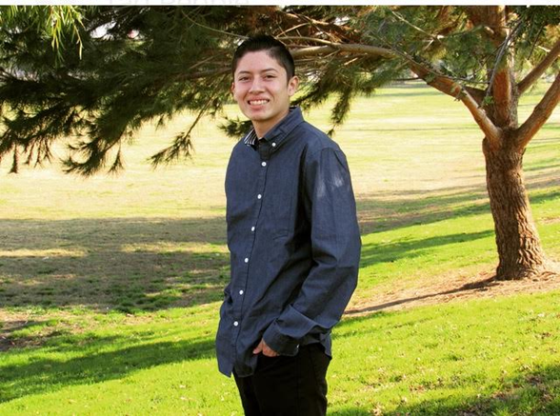
About Me
Born on September 4, 1999 in Lindsay CA
2 siblings
Enjoy playing/watching Sports
Challenge: Trying to live up to the high expectations

Slide 3
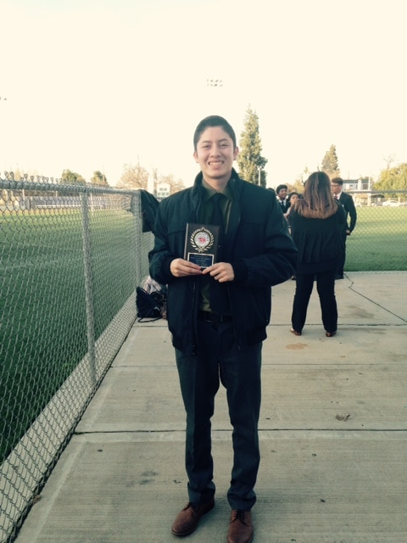
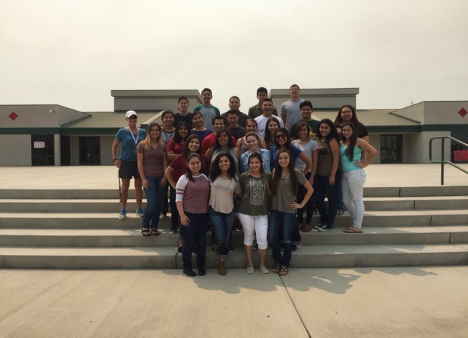
High School Experience
Clubs & Activities
FBLA
NSHS
AVID
CSF
REAP
Football
Challenges: Time Management
Successes: Graduating with Honors, Being named 2016 Youth of the year

Slide 4
Pathway
Business
Accounting 1, 2, & advanced
Have known I wanted to major in business
Many jobs & Opportunities

Slide 5
Job Shadow
Entrepreneur: Lindsay Lathrop (Networks2action)
Very time consuming & you’re your own boss
Entrepreneurship Project
This can be a job in the future if I get an idea that will be worth it.

Slide 6
Post High School Plans
California State University of Fresno
Financial Aid, Scholarships, Grants, Family support, & a job
Short & Long term goals:
Graduate from CSU Fresno with my Bachelor’s degree in Business Management
Become a Chief Executive Officer

Slide 7
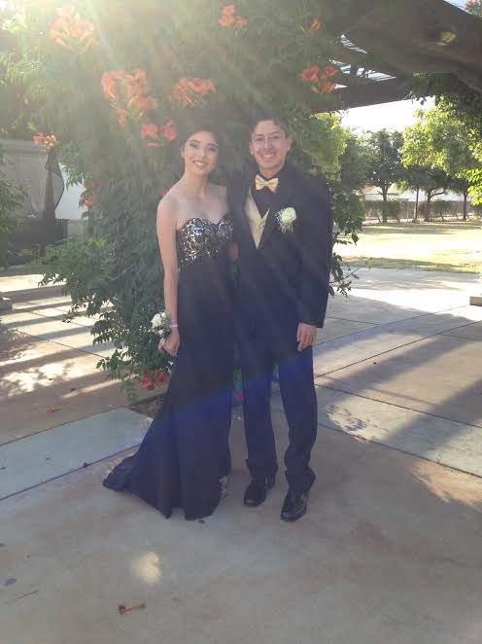
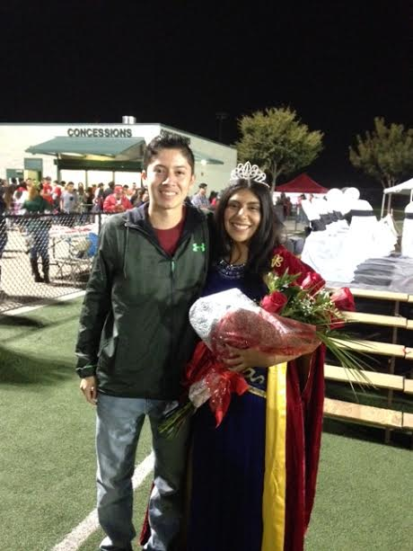
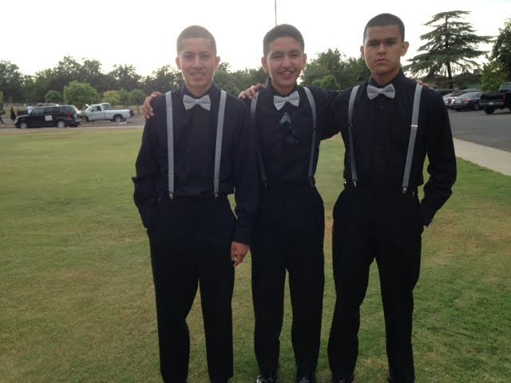
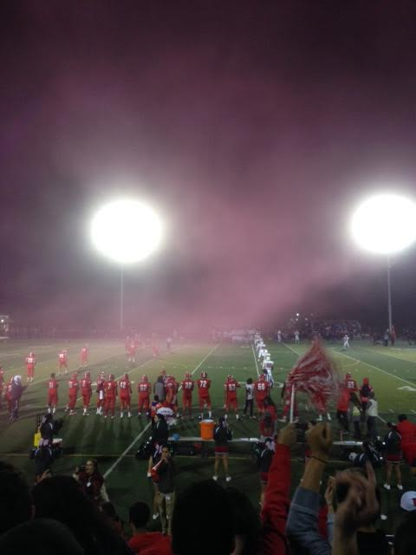
Leaving LHS
Mature, self-motivated, & focused
Mr. Gutierrez
PBS has taught me to more accountable & independent

Slide 8
Any Questions?

